Slide 1
Chapter 08: Advanced Counting Techniques Recurrence Relations
Definition: A recurrence relation for the sequence {a_{n}} is an equation that expresses a_{n} in terms of one or more of the previous terms of the sequence, namely, a₀, a₁, …, a_{n-1}, for all integers n with n ≥ n₀, where n₀ is a nonnegative integer.
A sequence is called a solution of a recurrence relation if its terms satisfy the recurrence relation.
The initial conditions for a sequence specify the terms that precede the first term where the recurrence relation takes effect.
FREE: For Complete Playlist: https://www.youtube.com/c/FahadHussaintutorial/playlists
For Code, Slide and Books: https://fahadhussaincs.blogspot.com/

Slide 2
Chapter 08: Advanced Counting Techniques Recurrence Relations
FREE: For Complete Playlist: https://www.youtube.com/c/FahadHussaintutorial/playlists
For Code, Slide and Books: https://fahadhussaincs.blogspot.com/

Slide 3
Chapter 08: Advanced Counting Techniques Recurrence Relations
FREE: For Complete Playlist: https://www.youtube.com/c/FahadHussaintutorial/playlists
For Code, Slide and Books: https://fahadhussaincs.blogspot.com/

Slide 4
Rabbits and the Fiobonacci Numbers
8.1 Applications of Recurrence Relations
Example: A young pair of rabbits (one of each gender) is placed on an island. A pair of rabbits does not breed until they are 2 months old. After they are 2 months old, each pair of rabbits produces another pair each month.
Find a recurrence relation for the number of pairs of rabbits on the island after n months, assuming that rabbits never die.
FREE: For Complete Playlist: https://www.youtube.com/c/FahadHussaintutorial/playlists
For Code, Slide and Books: https://fahadhussaincs.blogspot.com/

Slide 5
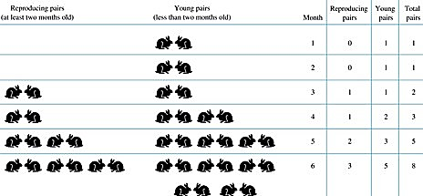
Rabbits and the Fiobonacci Numbers (cont.)
FREE: For Complete Playlist: https://www.youtube.com/c/FahadHussaintutorial/playlists
For Code, Slide and Books: https://fahadhussaincs.blogspot.com/

Slide 6
Rabbits and the Fibonacci Numbers (cont.)
Solution: Let f_{n} be the the number of pairs of rabbits after n months.
There are is f₁ = 1 pairs of rabbits on the island at the end of the first month.
We also have f₂ = 1 because the pair does not breed during the first month.
To find the number of pairs on the island after n months, add the number on the island after the previous month, f_{n-1}, and the number of newborn pairs, which equals f_{n-2}, because each newborn pair comes from a pair at least two months old.
Consequently the sequence {f_{n} } satisfies the recurrence relation
^{f}n ^{= f}n-1 ^{+ f}n-2
for n ≥ 3 with the initial conditions f₁ = 1 and f₂ = 1.
The number of pairs of rabbits on the island after n months is given by the nth Fibonacci number.
FREE: For Complete Playlist: https://www.youtube.com/c/FahadHussaintutorial/playlists
For Code, Slide and Books: https://fahadhussaincs.blogspot.com/

Slide 7
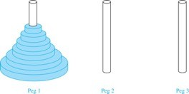
The Tower of Hanoi
Rules: You are allowed to move the disks one at a time from one peg to another as long as a larger disk is never placed on a smaller.
Goal: Using allowable moves, end up with all the disks on the second peg in order of size with largest on the bottom.
FREE: For Complete Playlist: https://www.youtube.com/c/FahadHussaintutorial/playlists
For Code, Slide and Books: https://fahadhussaincs.blogspot.com/

Slide 8
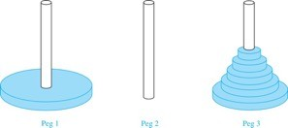
The Tower of Hanoi (continued)
Solution: Let {H_{n}} denote the number of moves needed to solve the Tower of Hanoi Puzzle with n disks. Set up a recurrence relation for the sequence {H_{n}}. Begin with n disks on peg 1. We can transfer the top n −1 disks, following the rules of the puzzle, to peg 3 using H_{n−1} moves.
First, we use 1 move to transfer the largest disk to the second peg. Then we transfer the n −1
disks from peg 3 to peg 2 using H_{n−1} additional moves. This can not be done in fewer steps.
Hence,
H_{n} = 2H_{n−1} + 1.
The initial condition is H₁= 1 since a single disk can be transferred from peg 1 to peg 2 in one move.
FREE: For Complete Playlist: https://www.youtube.com/c/FahadHussaintutorial/playlists
For Code, Slide and Books: https://fahadhussaincs.blogspot.com/

Slide 9
The Tower of Hanoi (continued)
We can use an iterative approach to solve this recurrence relation by repeatedly expressing H_{n} in terms of the previous terms of the sequence.
H_{n} = 2H_{n−1} + 1
= 2(2H_{n−2} + 1) + 1 = 2² H_{n−2} +2 + 1
= 2²(2H_{n−3} + 1) + 2 + 1 = 2³ H_{n−3} +2² + 2 + 1
⋮
= 2^{n-1}H + 2^{n−2} + 2^{n−3} + …. + 2 + 1
1
= 2^{n−1} + 2^{n−2} + 2^{n−3} + …. + 2 + 1 because H = 1
1
= 2^{n} − 1 using the formula for the sum of the terms of a geometric series
There was a myth created with the puzzle. Monks in a tower in Hanoi are transferring 64 gold disks from one peg to another following the rules of the puzzle. They move one disk each day. When the puzzle is finished, the world will end.
Using this formula for the 64 gold disks of the myth,
2⁶⁴ −1 = 18,446, 744,073, 709,551,615
days are needed to solve the puzzle, which is more than 500 billion years.
Reve’s puzzle (proposed in 1907 by Henry Dudeney) is similar but has 4 pegs. There is a well-known unsettled conjecture for the the minimum number of moves needed to solve this puzzle. (see Exercises 38-45)

Slide 10
Counting Bit Strings
Example 3: Find a recurrence relation and give initial conditions for the number of bit strings of length n without two consecutive 0s. How many such bit strings are there of length five?
Solution: Let a_{n} denote the number of bit strings of length n without two consecutive 0s. To obtain a recurrence relation for {a_{n} } note that the number of bit strings of length n that do not have two consecutive 0s is the number of bit strings ending with a 0 plus the number of such bit strings ending with a 1.
FREE: For Complete Playlist: https://www.youtube.com/c/FahadHussaintutorial/playlists
For Code, Slide and Books: https://fahadhussaincs.blogspot.com/

Slide 11
Bit Strings (continued)
The initial conditions are:
a₁ = 2, since both the bit strings 0 and 1 do not have consecutive 0s.
a₂ = 3, since the bit strings 01, 10, and 11 do not have consecutive 0s, while 00 does.
To obtain a₅ , we use the recurrence relation three times to find that:
a₃ = a₂ + a₁ = 3 + 2 = 5
a₄ = a₃ + a₂ = 5+ 3 = 8
a₅ = a₄ + a₃ = 8+ 5 = 13
Note that {a_{n} } satisfies the same recurrence relation as the Fibonacci sequence. Since a₁ = f₃ and a₂ = f₄ , we conclude that a_{n} = f_{n+2} .
FREE: For Complete Playlist: https://www.youtube.com/c/FahadHussaintutorial/playlists
For Code, Slide and Books: https://fahadhussaincs.blogspot.com/

Slide 12
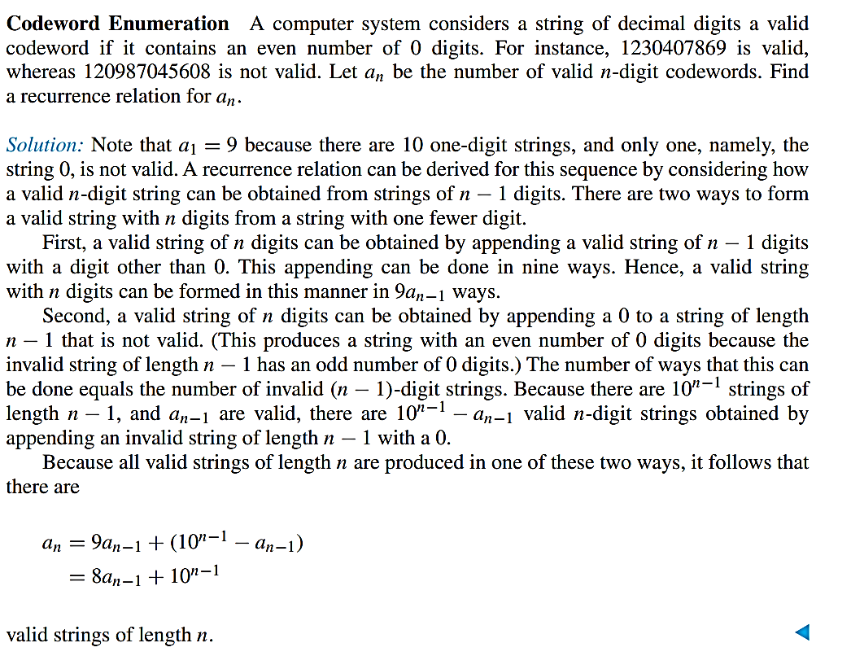

Slide 13
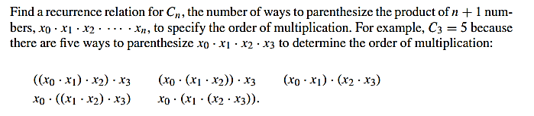
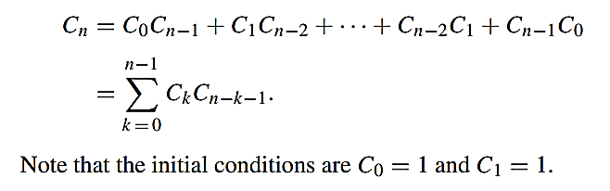
Counting the Ways to Parenthesize a Product
FREE: For Complete Playlist: https://www.youtube.com/c/FahadHussaintutorial/playlists
For Code, Slide and Books: https://fahadhussaincs.blogspot.com/

Slide 14
Algorithms and Recurrence Relations Recurrence relations play an important role in many aspects of the study of algorithms and their complexity. In Section 8.3, we will show how recurrence relations can be used to analyze the complexity of divide-and-conquer algorithms, such as the merge sort algorithm introduced in Section 5.4. As we will see in Section 8.3, divide-and-conquer algorithms recursively divide a problem into a fixed number of non-overlapping subproblems until they become simple enough to solve directly. We conclude this section by introducing another algorithmic paradigm known as dynamic programming, which can be used to solve many optimization problems efficiently
FREE: For Complete Playlist: https://www.youtube.com/c/FahadHussaintutorial/playlists
For Code, Slide and Books: https://fahadhussaincs.blogspot.com/

Slide 15
Solving Linear Recurrence Relations Section: 8.2
Section 8.2
FREE: For Complete Playlist: https://www.youtube.com/c/FahadHussaintutorial/playlists
For Code, Slide and Books: https://fahadhussaincs.blogspot.com/

Slide 16
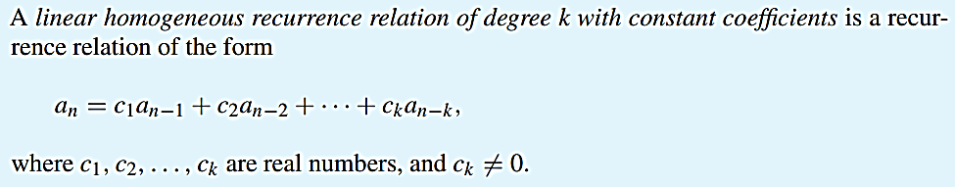
Linear Homogeneous Recurrence Relations
It is linear because the right-hand side is a sum of the previous terms of the sequence each multiplied by a function of n.
It is homogeneous because no terms occur that are not multiples of the a_{j}s. Each coefficient constant.
The degree is k because an is expressed in terms of the previous k terms of the sequence.
FREE: For Complete Playlist: https://www.youtube.com/c/FahadHussaintutorial/playlists
For Code, Slide and Books: https://fahadhussaincs.blogspot.com/

Slide 17
Example Linear Homogeneous Recurrence Relations
P_{n} = (1.11)P_{n-1} linear homogeneous recurrence relation of degree one
^{f}n ^{= f}n-1 ^{+ f}n-2
linear homogeneous recurrence
relation of degree two
not linear
H_{n} = 2H_{n−1} + 1 not homogeneous
B_{n} = nB_{n−1} coefficients are not constants
FREE: For Complete Playlist: https://www.youtube.com/c/FahadHussaintutorial/playlists
For Code, Slide and Books: https://fahadhussaincs.blogspot.com/

Slide 18
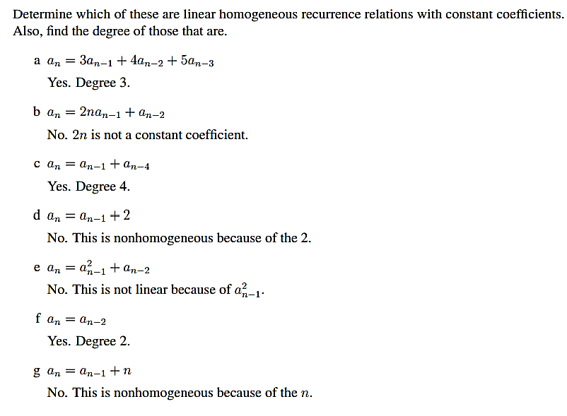
FREE: For Complete Playlist: https://www.youtube.com/c/FahadHussaintutorial/playlists
For Code, Slide and Books: https://fahadhussaincs.blogspot.com/

Slide 19
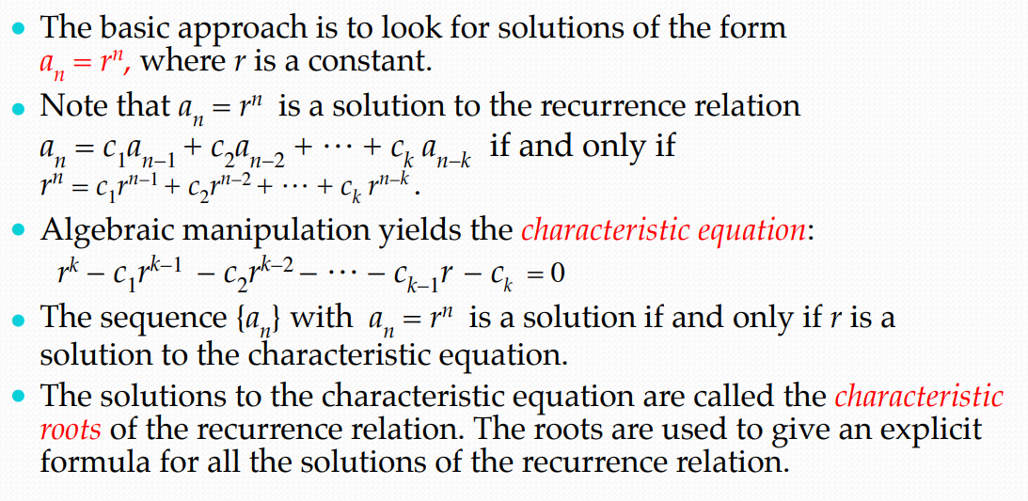
Solving Linear Homogeneous Recurrence Relations
FREE: For Complete Playlist: https://www.youtube.com/c/FahadHussaintutorial/playlists
For Code, Slide and Books: https://fahadhussaincs.blogspot.com/

Slide 20
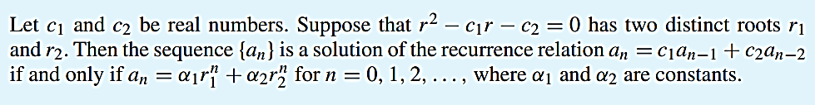
THEOREM 1
FREE: For Complete Playlist: https://www.youtube.com/c/FahadHussaintutorial/playlists
For Code, Slide and Books: https://fahadhussaincs.blogspot.com/

Slide 21
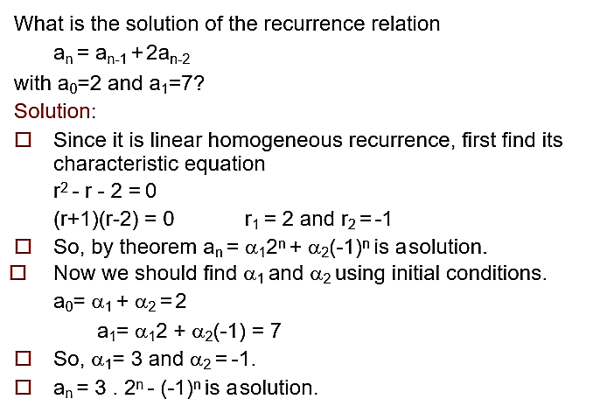
Second Order R.R Examples using Theorem 1
FREE: For Complete Playlist: https://www.youtube.com/c/FahadHussaintutorial/playlists
For Code, Slide and Books: https://fahadhussaincs.blogspot.com/

Slide 22
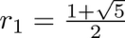
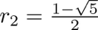
An Explicit Formula for the Fibonacci Numbers
We can use Theorem 1 to find an explicit formula for the Fibonacci numbers. The sequence of Fibonacci numbers
satisfies the recurrence relation + f_{n−2} with the
^{f}n ^{= f}n−1
initial conditions: f₀ = 0 and f₁ = 1.
Solution: The roots of the characteristic equation
r² – r – 1 = 0 are
FREE: For Complete Playlist: https://www.youtube.com/c/FahadHussaintutorial/playlists
For Code, Slide and Books: https://fahadhussaincs.blogspot.com/

Slide 23
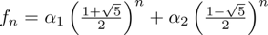
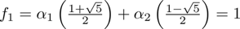
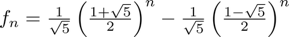
Fibonacci Numbers (continued)
Therefore by Theorem 1
for some constants α₁ and α₂.
Using the initial conditions f₀ = 0 and f₁ = 1 , we have
.
Solving, we obtain Hence,
,
.
FREE: For Complete Playlist: https://www.youtube.com/c/FahadHussaintutorial/playlists
For Code, Slide and Books: https://fahadhussaincs.blogspot.com/

Slide 24
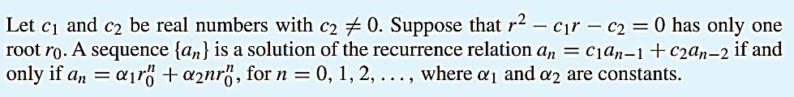
THEOREM 2
FREE: For Complete Playlist: https://www.youtube.com/c/FahadHussaintutorial/playlists
For Code, Slide and Books: https://fahadhussaincs.blogspot.com/

Slide 25
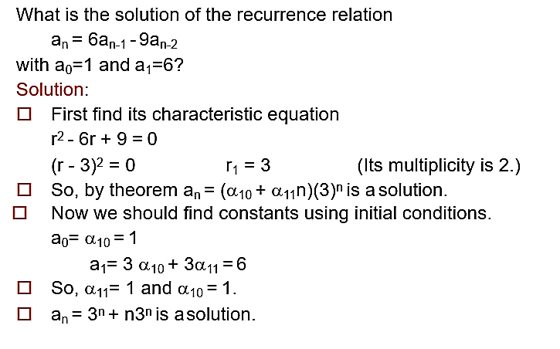
Using Theorem 2
FREE: For Complete Playlist: https://www.youtube.com/c/FahadHussaintutorial/playlists
For Code, Slide and Books: https://fahadhussaincs.blogspot.com/

Slide 26
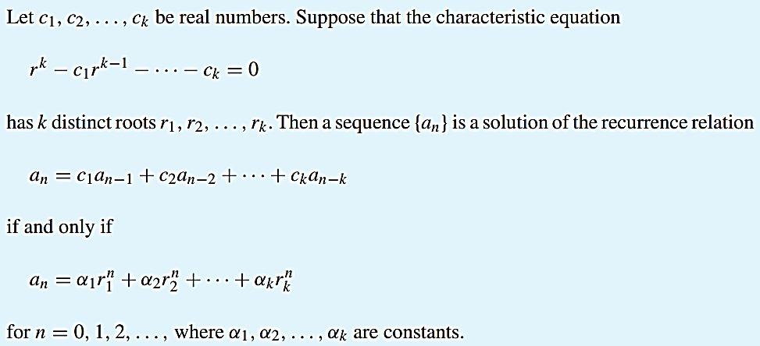
THEOREM 3
FREE: For Complete Playlist: https://www.youtube.com/c/FahadHussaintutorial/playlists
For Code, Slide and Books: https://fahadhussaincs.blogspot.com/

Slide 27
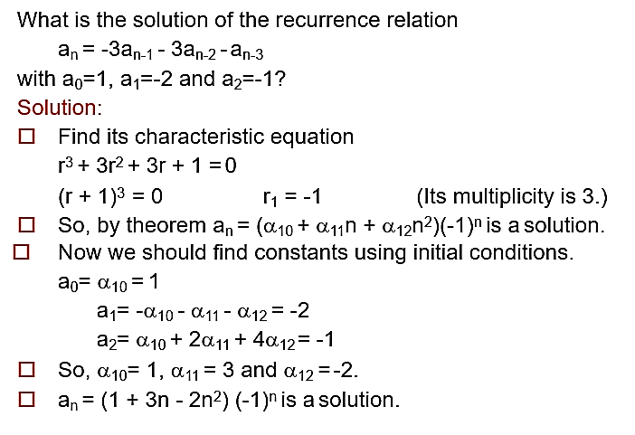
Using Theorem 3
FREE: For Complete Playlist: https://www.youtube.com/c/FahadHussaintutorial/playlists
For Code, Slide and Books: https://fahadhussaincs.blogspot.com/

Slide 28
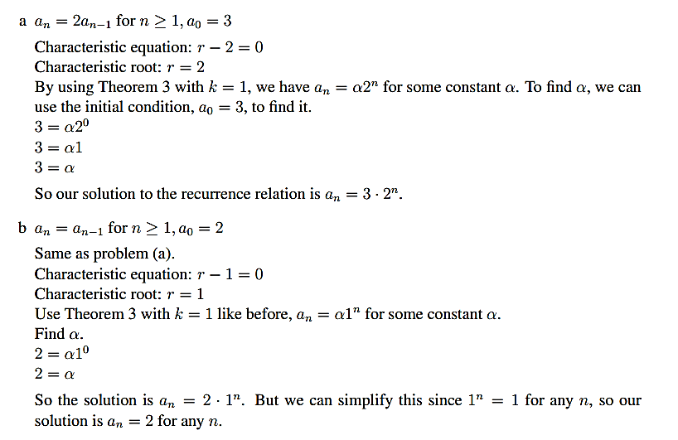
First Order R.R Examples
FREE: For Complete Playlist: https://www.youtube.com/c/FahadHussaintutorial/playlists
For Code, Slide and Books: https://fahadhussaincs.blogspot.com/

Slide 29
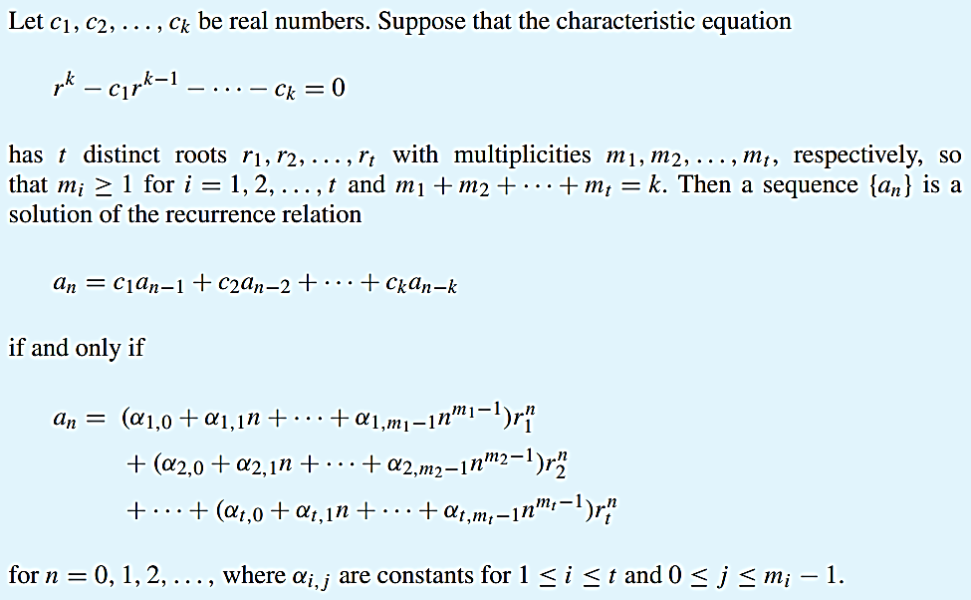
Theorem 4
FREE: For Complete Playlist: https://www.youtube.com/c/FahadHussaintutorial/playlists
For Code, Slide and Books: https://fahadhussaincs.blogspot.com/

Slide 30
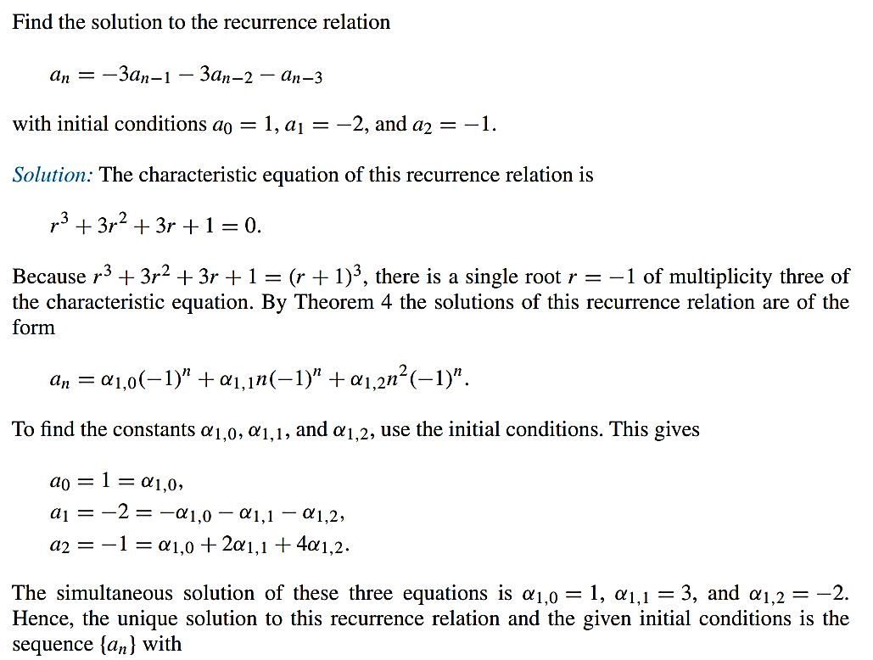
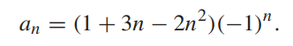
Using Theorem 4

Slide 31
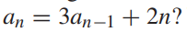
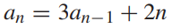
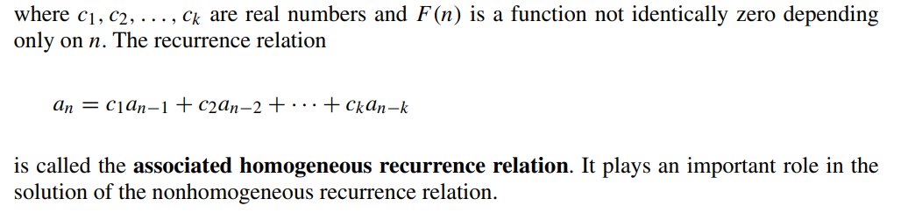
Linear Nonhomogeneous Recurrence Relations with Constant Coefficients
We have seen how to solve linear homogeneous recurrence relations with constant coefficients. Is there a relatively simple technique for solving a linear, but not homogeneous, recurrence relation with constant coefficients, such as ? We will see that the answer is yes for certain families of such recurrence relations. The recurrence relation
is an example of a linear nonhomogeneous recurrence relation with constant coefficients, that is, a recurrence relation of the form
FREE: For Complete Playlist: https://www.youtube.com/c/FahadHussaintutorial/playlists
For Code, Slide and Books: https://fahadhussaincs.blogspot.com/

Slide 32
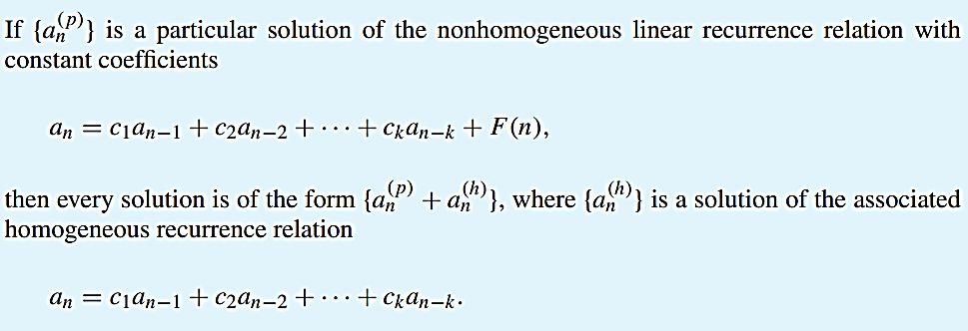
Theorem 5
FREE: For Complete Playlist: https://www.youtube.com/c/FahadHussaintutorial/playlists
For Code, Slide and Books: https://fahadhussaincs.blogspot.com/

Slide 33
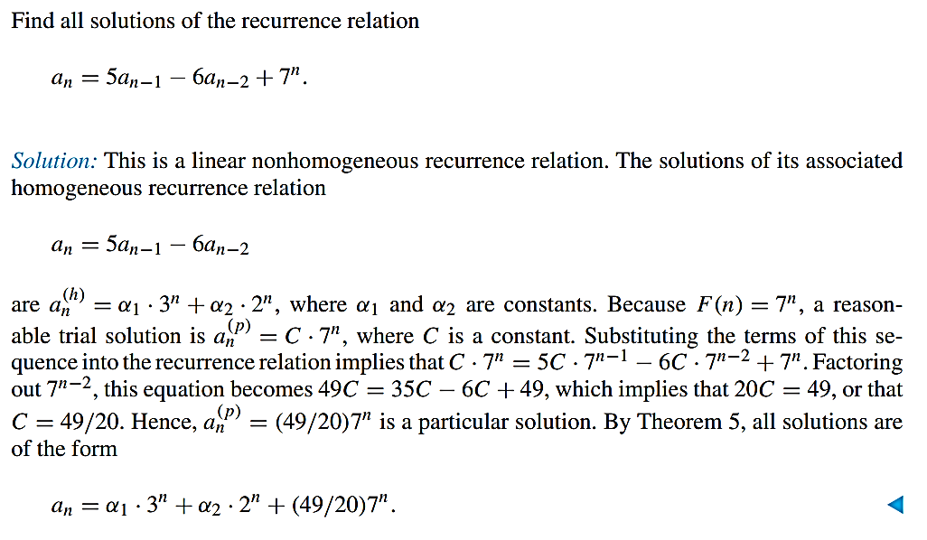
Using Theorem 5
FREE: For Complete Playlist: https://www.youtube.com/c/FahadHussaintutorial/playlists
For Code, Slide and Books: https://fahadhussaincs.blogspot.com/

Slide 34
Linear Nonhomogeneous Recurrence Relations with Constant Coefficients (cont.)
The following are linear nonhomogeneous recurrence relations with constant coefficients:
n
a_{n} = a_{n−1} + 2 ,
2
a_{n} = a_{n−1} + a_{n−2} + n + n + 1,
n
a_{n} = 3a_{n−1} + n3 ,
a_{n} = a_{n−1} + a_{n−2} + a_{n−3} + n!
where the following are the associated linear homogeneous recurrence relations, respectively:
ªn ^{= a}n−1 ,
ªn ^{= a}n−1 ^{+ a}n−2, a_{n} = 3a_{n−1} ,
ªn ^{= a}n−1 ^{+ a}n−2 ^{+ a}n−3
FREE: For Complete Playlist: https://www.youtube.com/c/FahadHussaintutorial/playlists
For Code, Slide and Books: https://fahadhussaincs.blogspot.com/

Slide 35
Divide-and-Conquer Algorithms and Recurrence Relations
Section 8.3

Slide 36
Divide-and-Conquer Algorithms and Recurrence Relations
Section 8.3
Divide-and-Conquer Algorithmic Paradigm
Definition: A divide-and-conquer algorithm works by first dividing a problem into one or more instances of the same problem of smaller size and then conquering the problem using the solutions of the smaller problems to find a solution of the original problem.
Examples:
Binary search, covered in Chapters 3 and 5: It works by comparing the element to be located to the middle element. The original list is then split into two lists and the search continues recursively in the appropriate sublist.
Merge sort, covered in Chapter 5: A list is split into two approximately equal sized sublists, each recursively sorted by merge sort. Sorting is done by successively merging pairs of lists.
●
FREE: For Complete Playlist: https://www.youtube.com/c/FahadHussaintutorial/playlists
For Code, Slide and Books: https://fahadhussaincs.blogspot.com/

Slide 37
Divide-and-Conquer Recurrence Relation
Suppose that a recursive algorithm divides a problem of size n into a subproblems.
Assume each subproblem is of size n/b.
Suppose g(n) extra operations are needed in the conquer step.
Then f(n) represents the number of operations to solve a problem of size n satisisfies the following recurrence relation:
f(n) = af(n/b) + g(n)
This is called a divide-and-conquer recurrence relation.
FREE: For Complete Playlist: https://www.youtube.com/c/FahadHussaintutorial/playlists
For Code, Slide and Books: https://fahadhussaincs.blogspot.com/

Slide 38
Example: Binary Search
Binary search reduces the search for an element in a sequence of size n to the search in a sequence of size n/2. Two comparisons are needed to implement this reduction;
one to decide whether to search the upper or lower half of the sequence and
the other to determine if the sequence has elements.
Hence, if f(n) is the number of comparisons required to search for an element in a sequence of size n, then
f(n) = f(n/2) + 2
when n is even.
FREE: For Complete Playlist: https://www.youtube.com/c/FahadHussaintutorial/playlists
For Code, Slide and Books: https://fahadhussaincs.blogspot.com/

Slide 39
Example: Merge Sort
The merge sort algorithm splits a list of n (assuming n is even) items to be sorted into two lists with n/2 items. It uses fewer than n comparisons to merge the two sorted lists.
Hence, the number of comparisons required to sort a sequence of size n, is no more than than M(n) where
M(n) = 2M(n/2) + n.
FREE: For Complete Playlist: https://www.youtube.com/c/FahadHussaintutorial/playlists
For Code, Slide and Books: https://fahadhussaincs.blogspot.com/

Slide 40
Example: Fast Multiplication of Integers
An algorithm for the fast multiplication of two 2n-bit integers (assuming n is even) first splits each of the 2n-bit integers into two blocks, each of n bits.
Suppose that a and b are integers with binary expansions of length 2n. Let
a = (a_{2n−1}a_{2n−2} … a₁a₀)₂ and b = (b_{2n−1}b_{2n−2} … b₁b₀)₂ .
●
●
Let a = 2^{n}A + A , b = 2^{n}B + B , where
1 0 1 0
A₁ = (a_{2n−1} … a_{n+1}a_{n})₂ , A₀ = (a_{n−1} … a₁a₀)₂ , B₁ = (b_{2n−1} … b_{n+1}b_{n})₂ , B₀ = (b_{n−1} … b₁b₀)₂.
The algorithm is based on the fact that ab can be rewritten as:
ab = (2^{2n} + 2^{n})A B +2^{n} (A −A )(B − B ) +(2^{n} + 1)A B .
1 1 1 0 0 1 0 0
This identity shows that the multiplication of two 2n-bit integers can be carried out using three multiplications of n-bit integers, together with additions, subtractions, and shifts.
Hence, if f(n) is the total number of operations needed to multiply two n-bit integers, then
●
●
●
f(2n) = 3f(n) + Cn
where Cn represents the total number of bit operations; the additions, subtractions and shifts that are a constant multiple of n-bit operations.
FREE: For Complete Playlist: https://www.youtube.com/c/FahadHussaintutorial/playlists
For Code, Slide and Books: https://fahadhussaincs.blogspot.com/

Slide 41
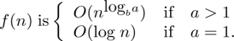
Estimating the Size of Divide-and-Conquer Functions
Theorem 1: Let f be an increasing function that satisfies the recurrence relation
f(n) = af(n/b) + cn^{d}
whenever n is divisible by b, where a≥ 1, b is an integer greater than 1, and c is a positive real number. Then
Furthermore, when n = b^{k} and a ≠1, where k is a positive integer,
where C₁ = f(1) + c/(a−1) and C₁ = −c/(a−1).
FREE: For Complete Playlist: https://www.youtube.com/c/FahadHussaintutorial/playlists
For Code, Slide and Books: https://fahadhussaincs.blogspot.com/

Slide 42
Complexity of Binary Search
Binary Search Example: Give a big-O estimate for the number of comparisons used by a binary search.
Solution: Since the number of comparisons used by binary search is f(n) = f(n/2) + 2 where n is even, by Theorem 1, it follows that f(n) is O(log n).
FREE: For Complete Playlist: https://www.youtube.com/c/FahadHussaintutorial/playlists
For Code, Slide and Books: https://fahadhussaincs.blogspot.com/

Slide 43
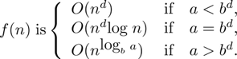
Estimating the Size of Divide-and-conquer Functions (continued)
Theorem 2. Master Theorem: Let f be an increasing function that satisfies the recurrence relation
f(n) = af(n/b) + cn^{d}
whenever n = b^{k}, where k is a positive integer greater than 1, and c and d are real numbers with c positive and d nonnegative. Then
FREE: For Complete Playlist: https://www.youtube.com/c/FahadHussaintutorial/playlists
For Code, Slide and Books: https://fahadhussaincs.blogspot.com/

Slide 44
Complexity of Merge Sort
Merge Sort Example: Give a big-O estimate for the number of comparisons used by merge sort.
Solution: Since the number of comparisons used by merge sort to sort a list of n elements is less than M(n) where M(n) = 2M(n/2) + n, by the master theorem M(n) is O(n log n).
FREE: For Complete Playlist: https://www.youtube.com/c/FahadHussaintutorial/playlists
For Code, Slide and Books: https://fahadhussaincs.blogspot.com/

Slide 45
Complexity of Fast Integer Multiplication Algorithm
Integer Multiplication Example: Give a big-O estimate for the number of bit operations used needed to multiply two n-bit integers using the fast multiplication algorithm.
Solution: We have shown that f(n) = 3f(n/2) + Cn, when n is even, where f(n) is the number of bit operations needed to multiply two n-bit integers. Hence by the master theorem with a = 3, b = 2, c = C, and d = 0 (so that we have the case where a > b^{d}), it follows that f(n) is O(n^{log 3}).
Note that log 3 ≈ 1.6. Therefore the fast multiplication algorithm is a substantial improvement over the conventional algorithm that uses O(n²) bit operations.
FREE: For Complete Playlist: https://www.youtube.com/c/FahadHussaintutorial/playlists
For Code, Slide and Books: https://fahadhussaincs.blogspot.com/

Slide 46

Generating Functions
Section 8.4

Slide 47
Section Summary
Generating Functions
Counting Problems and Generating Functions
Useful Generating Functions
Solving Recurrence Relations Using Generating Functions (not yet covered in the slides)
Proving Identities Using Generating Functions (not yet covered in the slides)

Slide 48
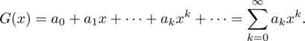
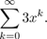
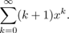
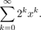
Generating Functions
Definition: The generating function for the sequence a₀, a₁,
…, a_{k}, … of real numbers is the infinite series
Examples:
The sequence {a_{k}} with a_{k} = 3 has the generating function
The sequence {a_{k}} with a_{k} = k + 1 has the generating function has the generating function
The sequence {a_{k}} with a_{k} = 2^{k} has the generating function
FREE: For Complete Playlist: https://www.youtube.com/c/FahadHussaintutorial/playlists
For Code, Slide and Books: https://fahadhussaincs.blogspot.com/

Slide 49
Generating Functions for Finite Sequences
Generating functions for finite sequences of real numbers can be defined by extending a finite sequence a₀,a₁, … , a_{n} into an infinite sequence by setting
a_{n+1} = 0, a_{n+2} = 0, and so on.
The generating function G(x) of this infinite sequence
{a_{n}} is a polynomial of degree n because no terms of the
form a_{j}x^{j} with j > n occur, that is,
G(x) = a₀ + a₁x + …⋯ + a_{n} x^{n}.

Slide 50
Generating Functions for Finite Sequences (continued)
Example: What is the generating function for the sequence 1,1,1,1,1,1?
Solution: The generating function of 1,1,1,1,1,1 is 1 + x + x² + x³ + x⁴ + x⁵.
By Theorem 1 of Section 2.4, we have (x⁶ − 1)/(x −1) = 1 + x + x² + x³ + x⁴ + x⁵
when x ≠ 1.
Consequently G(x) = (x⁶ − 1)/(x −1) is the generating function of the sequence.

Slide 51
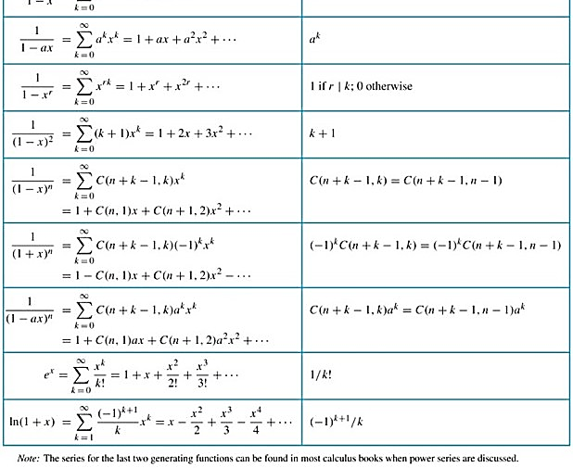

Slide 52
Counting Problems and Generating Functions
Example: Find the number of solutions of
e₁ + e₂ + e₃ = 17,
where e₁, e₂, and e₃ are nonnegative integers with
2 ≤ e₁≤ 5, 3 ≤ e₂ ≤ 6, and 4 ≤ e₃ ≤ 7.
Solution: The number of solutions is the coefficient of x¹⁷ in the expansion of
(x² + x³ + x⁴ + x⁵) (x³ + x⁴ + x⁵ + x⁶) (x⁴ + x⁵ + x⁶ + x⁷).
This follows because a term equal to is obtained in the product by picking a term in the first sum x^{e1}, a term in the second sum x^{e2}, and a term in the third sum x^{e3}, where e₁ + e₂ + e₃ = 17.
There are three solutions since the coefficient of x¹⁷ in the product is 3.

Slide 53
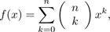
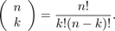
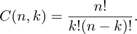
Counting Problems and Generating Functions (continued)
Example: Use generating functions to find the number of k-combinations of a set with n elements, i.e., C(n,k).
Solution: Each of the n elements in the set contributes the term (1 + x) to the generating function
Hence f(x) = (1 + x)^{n} where f(x) is the generating function for {a^{k}}, where a^{k}
represents the number of k-combinations of a set with n elements.
By the binomial theorem, we have
where
Hence,

Slide 54

Inclusion-Exclusion
Section 8.5

Slide 55
Principle of Inclusion-Exclusion
In Section 2.2, we developed the following formula for the number of elements in the union of two finite sets:
We will generalize this formula to finite sets of any size.

Slide 56
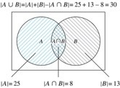
Two Finite Sets
Example: In a discrete mathematics class every student is a major in computer science or mathematics or both. The number of students having computer science as a major (possibly along with mathematics) is 25; the number of students having mathematics as a major (possibly along with computer science) is 13; and the number of students majoring in both computer science and mathematics is 8. How many students are in the class?
Solution: |A∪B| = |A| + |B| −|AΩB|
= 25 + 13 −8 = 30

Slide 57



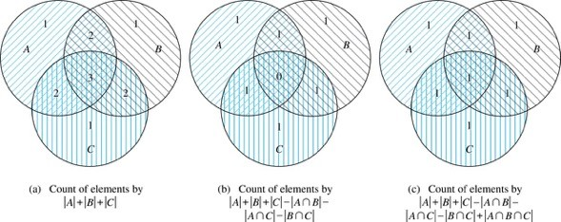
Three Finite Sets

Slide 58
Three Finite Sets Continued
Example: A total of 1232 students have taken a course in Spanish, 879 have taken a course in French, and 114 have taken a course in Russian. Further, 103 have taken courses in both Spanish and French, 23 have taken courses in both Spanish and Russian, and 14 have taken courses in both French and Russian. If 2092 students have taken a course in at least one of Spanish French and Russian, how many students have taken a course in all 3 languages.
Solution: Let S be the set of students who have taken a course in Spanish, F the set of students who have taken a course in French, and R the set of students who have taken a course in Russian. Then, we have
|S| = 1232, |F| = 879, |R| = 114, |SΩF| = 103, |SΩR| = 23, |FΩR| = 14, and
|S∪F∪R| = 23.
Using the equation
|S∪F∪R| = |S|+ |F|+ |R| − |SΩF| − |SΩR| − |FΩR| + |SΩFΩR|, we obtain 2092 = 1232 + 879 + 114 −103 −23 −14 + |SΩFΩR|.
Solving for |SΩFΩR| yields 7.

Slide 59
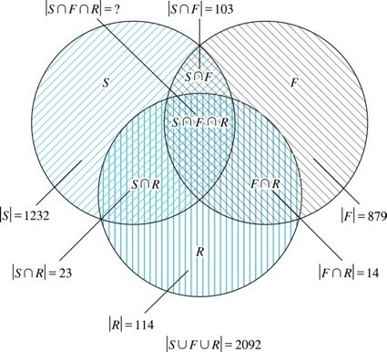
Illustration of Three Finite Set Example

Slide 60
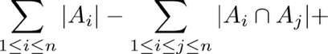
The Principle of Inclusion-Exclusion
Theorem 1. The Principle of Inclusion-Exclusion: Let A₁, A₂, …, A_{n} be finite sets. Then:

Slide 61
Inequality
≤
≥

Slide 62
The Principle of Inclusion-Exclusion (continued)
Proof: An element in the union is counted exactly once in the right-hand side of the equation. Consider an element a that is a member of r of the sets A₁,…., A_{n}
where 1≤ r ≤ n.
It is counted C(r,1) times by Σ|A_{i}|
It is counted C(r,2) times by Σ|A_{i} ⋂A_{j}|
In general, it is counted C(r,m) times by the summation of m of the sets A_{i}.

Slide 63
The Principle of Inclusion-Exclusion (cont)
Thus the element is counted exactly
C(r,1) − C(r,2) + C(r,3) − …⋯ + (−1)^{r+1} C(r,r)
times by the right hand side of the equation.
By Corollary 2 of Section 6.4, we have
C(r,0) − C(r,1) + C(r,2) − …⋯ + (−1)^{r} C(r,r) = 0.
Hence,
1 = C(r,0) = C(r,1) − C(r,2) + …⋯ + (−1)^{r+1} C(r,r).

Slide 64

Applications of Inclusion-Exclusion
Section 8.6

Slide 65
Section Summary
Counting Onto-Functions
Derangements

Slide 66
The Number of Onto Functions
Example: How many onto functions are there from a set with six elements to a set with three elements?
Solution: Suppose that the elements in the codomain are b₁, b₂, and b₃. Let P₁, P₂, and P₃ be the properties that b₁, b₂, and b₃ are not in the range of the function, respectively. The function is onto if none of the properties P₁, P₂, and P₃ hold.
By the inclusion-exclusion principle the number of onto functions from a set with six elements to a set with three elements is
N − [N(P₁) + N(P₂) + N(P₃)] +
[N(P₁P₂) + N(P₁P₃) + N(P₂P₃)] − N(P₁P₂P₃)
Here the total number of functions from a set with six elements to one with three elements is N = 3⁶.
The number of functions that do not have in the range is N(P₁) = 2⁶. Similarly, N(P₂) = N(3₁) = 2⁶ .
Note that N(P₁P₂) = N(P₁P₃) = N(P₂P₃) = 1 and N(P₁P₂P₃)= 0.
Hence, the number of onto functions from a set with six elements to a set with three elements is: 3⁶ − 3· 2⁶ + 3 = 729 − 192 + 3 = 540

Slide 67

The Number of Onto Functions (continued)
Theorem 1: Let m and n be positive integers with
m ≥ n. Then there are
onto functions from a set with m elements to a set with n elements.
Proof follows from the principle of inclusion-exclusion (see Exercise 27).

Slide 68
Derangements
Definition: A derangement is a permutation of objects that leaves no object in the original position.
Example: The permutation of 21453 is a derangement of 12345 because no number is left in its original position. But 21543 is not a derangement of 12345, because 4 is in its original position.

Slide 69
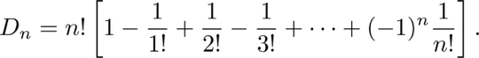
Derangements (continued)
Theorem 2: The number of derangements of a set with n elements is
Let Ai be the number of permutations that number i is in position i. Number of dearrangements is n!-|A1 ∪ A2 ∪ A3 ∪ A4….. ∪ An| Then |Ai|=(n-1)!,
|Ai ⋂ Aj|=(n-2)!
|Ai1⋂ Ai2⋂ Ai3……⋂ Aik|=(n-k)!

Slide 70
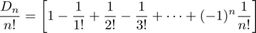
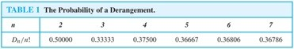
Derangements (continued)
The Hatcheck Problem: A new employee checks the hats of n people at restaurant, forgetting to put claim check numbers on the hats. When customers return for their hats, the checker gives them back hats chosen at random from the remaining hats. What is the probability that no one receives the correct hat.
Solution: The answer is the number of ways the hats can be arranged so that there is no hat in its original position divided by n!, the number of permutations of n hats.
Remark: It can be shown that the probability of a derangement approaches 1/e as n grows without bound.

